Slide 1

Analyzing Healthcare Reviews
IST 332: NLP Final Project
Group Members
Ahmed, Darby, Olga, Soren
Dec 10 2025

Slide 2
Contents
Contents
Introduction
Research Question
Relevance
Corpus Creation
Text Preprocessing
Data Understanding and Preparation
Sentiment analysis
Topic modeling
Supervised learning
Deployment Plan
Conclusion
00
01
02
03
04
05
06
08
09
10
11
12

Slide 3
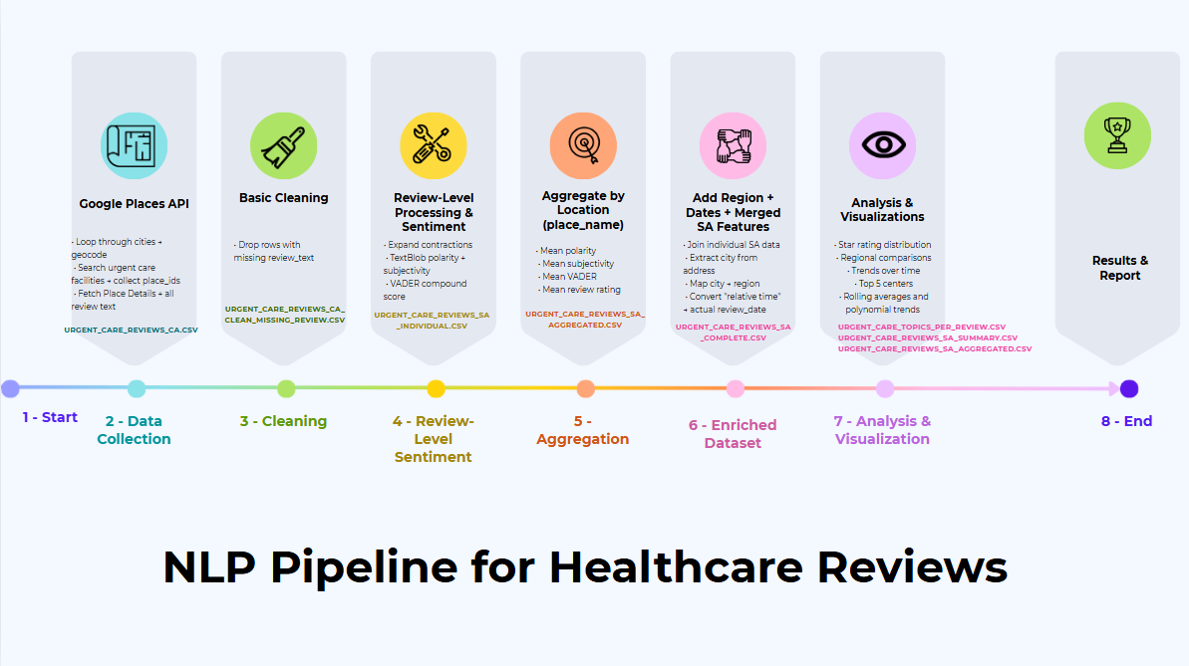
We are here

Slide 4
Introduction
Healthcare center visits are often stressful and time-sensitive.
Patient experiences become polarized, leading to mostly 1-star or 5-star reviews.
Online reviews capture real emotions and detailed experiences.
Text reviews reveal patterns about wait times, staff behavior, and service quality.
NLP can use these narratives to predict healthcare center quality.

Slide 5
Research Questions
Primary Question
How well can sentiment analysis and NLP techniques applied to Google Maps patient reviews predict urgent care quality of care ratings?
Secondary Question
Can online sentiment predict the overall averaged quality of selected urgent care?

Slide 6
Relevance
Dependence on online platforms is increasing for selecting healthcare providers; understanding the factors that drive patient satisfaction is more important than ever.
NLP can help unearth patient decision making and provider efforts to improve urgent care service delivery. This information can prove useful for many stakeholders, employees and healthcare providers included.

Slide 7
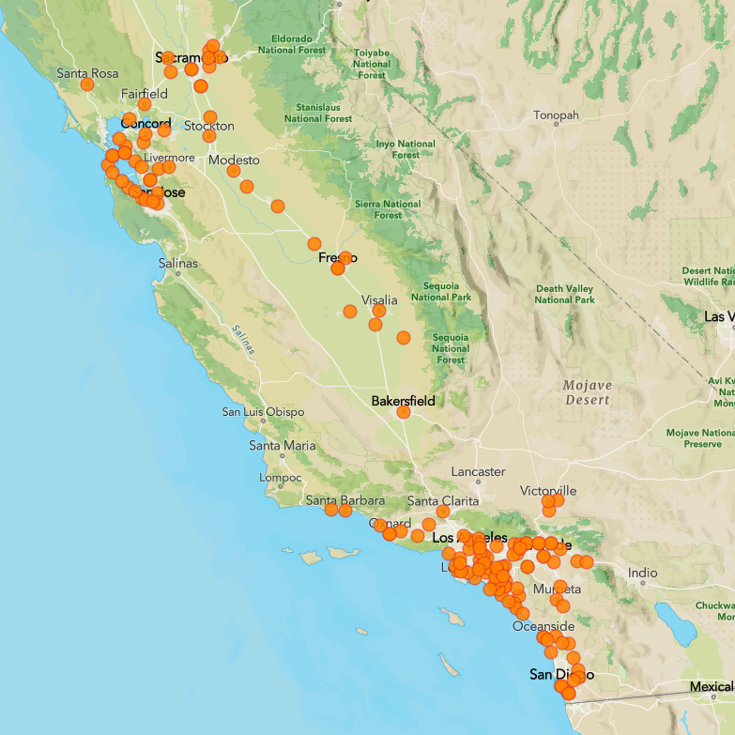
Corpus Creation
Data Source Overview
Dataset Source: Google Places API
Reason for Selection:
  Free public source with structured access
  Large number of user-generated reviews
  Consistent metadata and clear documentation
Focus of Dataset:
  Patient reviews for urgent care centers
  Locations across multiple California cities

Slide 8
Corpus Creation (contd)
Data Collection Workflow
Tools used: Google Place API + Python
Main Steps
  Create a list of locations (cities) across California
  Convert each city name into geographic coordinates using the Geocoding API.
  Use these coordinates as the center point for Places searches.
  For each city, query the Places Text Search API with terms such as:
    “urgent care”
    “walk-in clinic”
    “medical clinic”
    “emergency clinic”
  Collect reviews from all matched healthcare centers.
Dataset Size
Total Raw Reviews: 12,091

Slide 9
Corpus Creation (contd)
Ethical considerations and permissions
Data comes only from public Google Maps business listings.
Accessed through official APIs (no scraping).
Only review text and ratings are analyzed.
No attempt is made to identify or track individuals.
Dataset is used strictly for academic project purposes.

Slide 10
Corpus Creation (contd)
Metadata Summary
Feature | Description
Place ID | Unique Google identifier for the urgent care center
Place Name | Business name as shown on Google Maps
Place_address | Full address of the urgent care
Place_avg_rating | Overall Google rating for the urgent care
Place_user_ratings_total | Total number of ratings the urgent care has received
Place_types | Categories that describe the type of business
Review_rating | Rating given by the reviewer (1–5)
Review_text | Free-text patient feedback
review_relative_time_description | How long ago the review was written (e.g., “2 months ago”)

Slide 11
Text Preprocessing
Goal: standardize and clean text for NLP tasks
Core Cleaning Steps | Token-Level Processing
Remove empty and missing reviews (433 removed) | Tokenization using spaCy
Lowercase all text | Remove URLs, symbols, and punctuation
Contraction Expansion | Remove stopwords to focus on meaningful words
Expansion of medical abbreviations (dr → doctor) | Remove tokens with digits or fewer than two characters
Remove doctor names to avoid noise and protect identity | Apply lemmatization to convert words to base forms

Slide 12
Data Understanding and Preparation
Potential Data Issues
  Missing values in the review_text field
  Doctor names appearing in many reviews
How We Handled Them
  Removed missing reviews to keep only complete and usable data
  Removed doctor names to reduce noise and avoid personal identifiers
Summary Statistics
Total raw reviews: 12,091
Usable reviews after cleaning: 11,658
Final vocabulary: 15,798 unique terms
Average Tokens per Review: ~42 tokens per review
Top 20 Most Frequent Words
doctor, care, go, time, get, take, wait, make, see, patient, appointment, would, need, come, urgent, call, say, experience, tell, medical

Slide 13
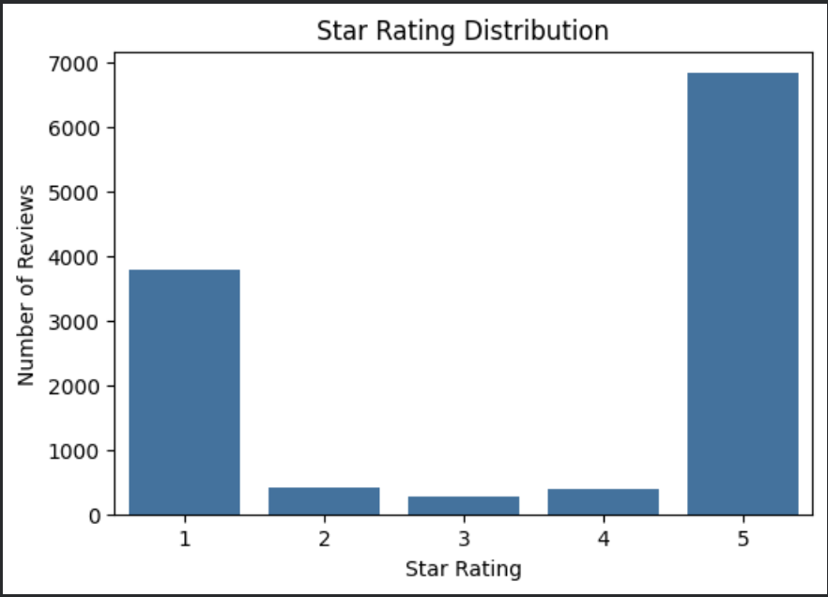
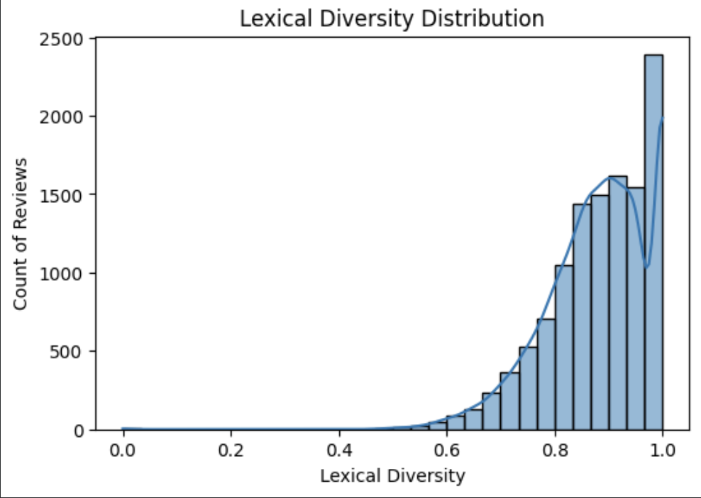
Data Understanding and Preparation (contd)
Summary Statistics
STAR RATING DISTRIBUTION | LEXICAL Diversity

Slide 14
Data Understanding and Preparation (contd)
Data Preparation for Downstream Tasks
Sentiment Analysis
  Use minimal cleaned review text, including expand contractions/medical abbreviations, lowercase text, and remove doctor names.
Topic Modeling
  Use fully cleaned review text, including tokenization, URL and symbols removal, stopwords removal, lemmatization,
Supervised Learning
  Use the same fully cleaned review text; review_rating as the target label

Slide 15
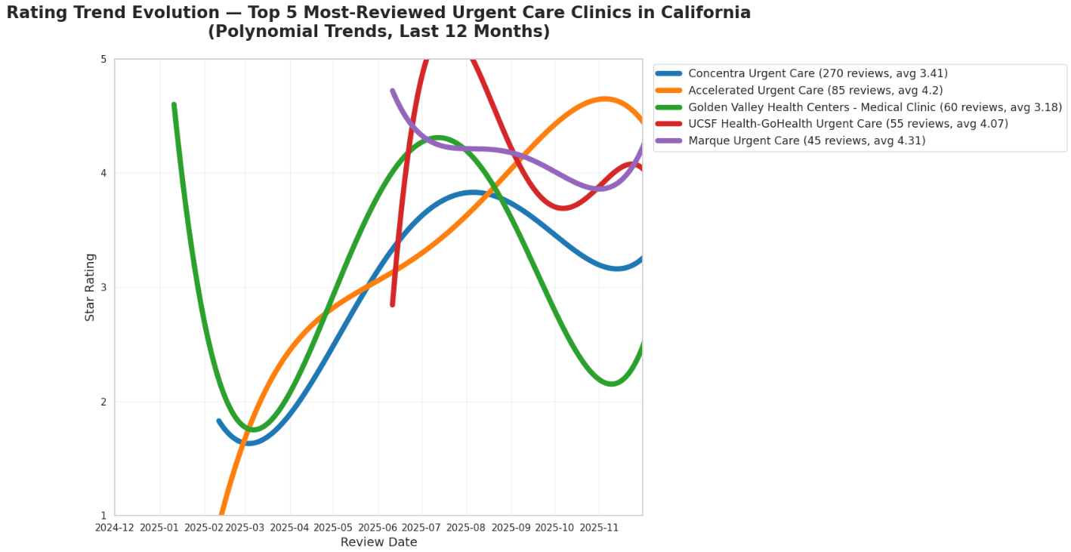
Data Understanding

Slide 16
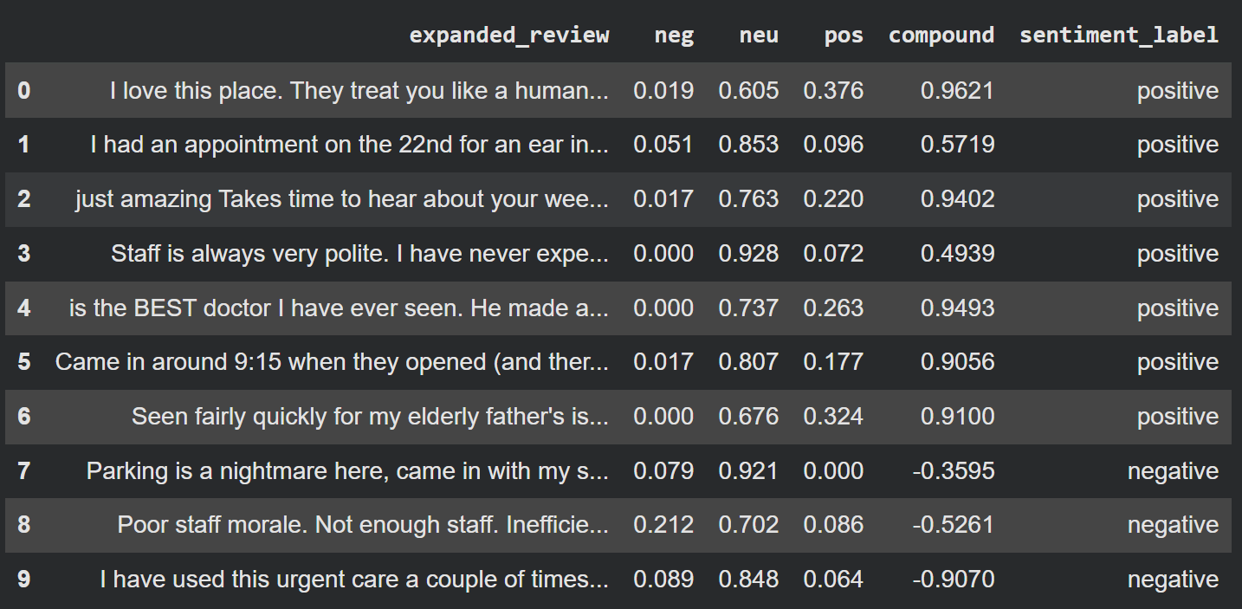
Sentiment Analysis
Positive: 8511
Negative: 2944
Neutral: 198

Slide 17
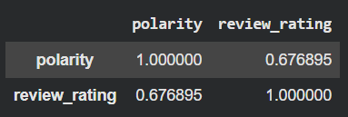
Sentiment Analysis (contd)
- H0 (Null Hypothesis):
There is no relationship between sentiment polarity and review ratings.
- H1 (Alternative Hypothesis):
Higher polarity (more positive sentiment) is associated with higher review ratings.
Test the Hypothesis (Using Correlation)
The Correlation between polarity and review_rating were used to test the hypothesis. The correlation between polarity and review rating is 0.6768, which indicates a strong positive relationship.

Slide 18
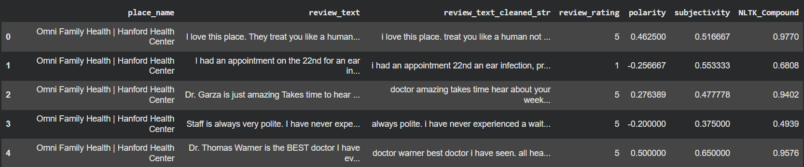
Sentiment Analysis (contd)

Slide 19
Topic Modeling
LDA with bag-of-words chosen for stronger interpretability and topic coherence.
Performs well on short, noisy review text, capturing meaningful patterns despite limited context.
Models word co-occurrence effectively, outperforming LSA for our use case.
Aligns with our preprocessing pipeline, enabling consistent extraction of key themes in patient feedback.

Slide 20
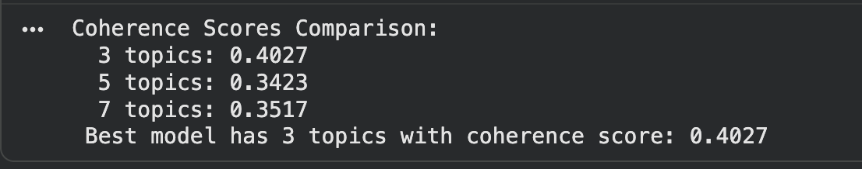
Topic Modeling (contd)

Slide 21
Topic Modeling (contd)
Topic 1 — “Quality of Care & Professionalism”
Words like care, doctor, experience, time, great, recommend, medical, take, professional, patient point to patients describing the overall quality of service, how they felt treated, and whether they would recommend the clinic.
Topic 2 — “Communication & Staff Interaction Issues”
Words such as doctor, go, tell, get, say, call, would, patient, ask, give show a theme of communication between staff and patients.
This topic reflects issues where patients mention: poor explanations, unreturned calls, unclear instructions, communication frustrations
It’s not about wait times or care quality—it's specifically about interactions and communication.
Topic 3 — “Wait Times & Appointment Delays”
Top words like wait, time, go, get, appointment, see, urgent_care, doctor, take, hour clearly point to delays, long waits, and scheduling problems.
This is a classic “wait time” topic seen in many healthcare review datasets.

Slide 22
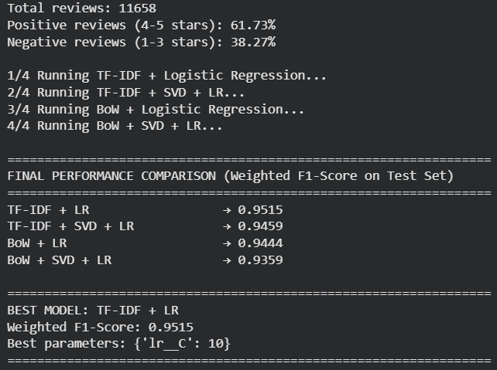
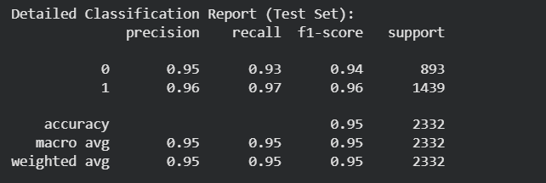
Supervised learning

Slide 23
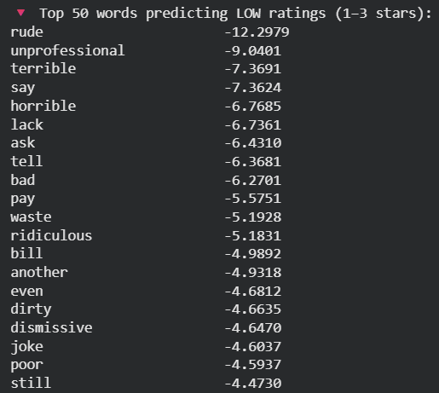
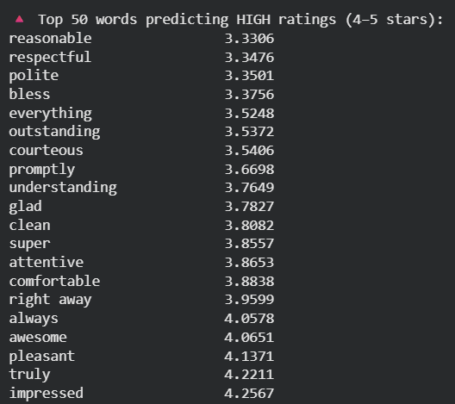
Quantify words that predict low vs. high ratings

Slide 24
Quantify words that predict low vs. high ratings (contd)
Topic 1 | care | doctor | experience | time | great | recommend | medical | take | professional | patient
Coef. | 0.96 | 3.32 | 1.15 | -3.51 | 11.57 | 6.06 | 0.40 | 5.59 | 6.509 | -3.89
Topic 2 | doctor | go | tell | get | say | call | would | patient | ask | give
Coef. | 3.32 | -1.27 | -6.37 | 0.38 | -7.36 | -3.17 | -3.09 | -3.89 | -6.43 | -1.22
Topic 3 | wait | time | go | get | appointment | see | urgent care | doctor | take | hour
Coef. | -2.15 | 3.32 | -1.27 | 0.38 | -2.30 | -1.11 | 0.02 | 3.32 | 0.68 | -3.60

Slide 25
Deployment Plan
Target Application Overview
Monitoring Performance & Ethics Over Time
Model Serving / Prediction Workflow
Model Retraining/Updating
Automation of Data Collection

Slide 26
Conclusion
LDA with bag-of-words chosen for stronger interpretability and topic coherence.
Strong positive relationship between polarity and review ratings
Important for seeing gaps in customer engagement in different topics -> can be used by administrators to track problems and take customer feedback into account without much customer intervention.

Slide 27
References
Evans, D. A., Ginther-Webster, K., Hart, M., Lefferts, R. G., & Monarch, I. (1991). Automatic indexing using selective NLP and first-order thesauri. In Proceedings of the Intelligent Multimedia Information Retrieval Systems & Management (RIAO ’91) (pp. 624–643). Elsevier. DBLP+1
Wallace, B. C., Paul, M. J., Sarkar, U., & Trikalinos, T. A. (2015). A large-scale analysis of online patient reviews using latent Dirichlet allocation. Journal of the American Medical Informatics Association, 22(6), 1219–1226. CMU School of Computer Science+1
Greaves, F., Ramirez-Cano, D., Millett, C., Darzi, A., & Donaldson, L. (2013). Patients’ ratings of health care providers: Sentiment analysis of NHS provider reviews. Journal of Medical Internet Research, 15(11), e239.
Beckett, M. K., Quigley, D. D., Lehrman, W. G., Giordano, L. A., Cohea, C. W., Goldstein, E. H., & Elliott, M. N. (2024). Interventions and hospital characteristics associated with patient experience: An update of the evidence. Medical Care Research and Review, 81(3), 195–208
Wu, S., Roberts, K., Datta, S., Du, J., Ji, Z., Si, Y., … & Xu, H. (2020). Deep learning in clinical natural language processing: A methodical survey. Journal of the American Medical Informatics Association, 27(12), 1875–1888.
Roberts, L. W. (2020). Ethical considerations in the use of social media and online review data in healthcare quality improvement. Academic Medicine, 95(6), 888–893.

Slide 28
Thank you
Any Questions?

